Slide 1
Pitfalls in microbiome accuracy and reproducibility

Slide 2
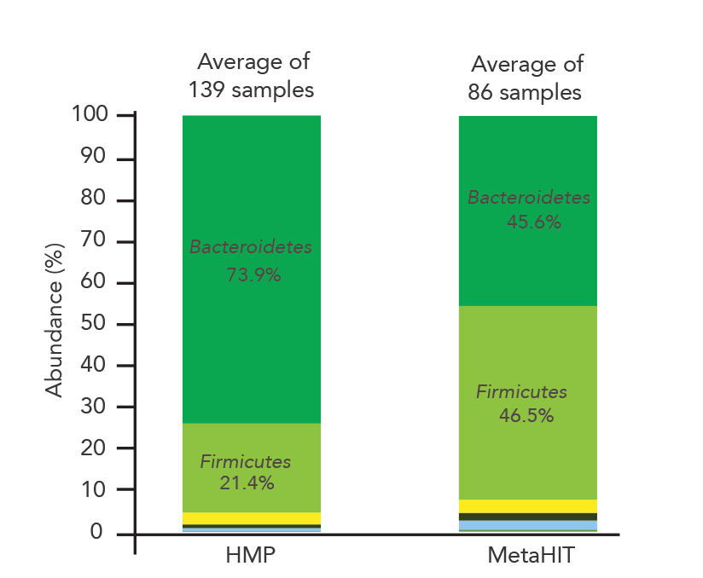
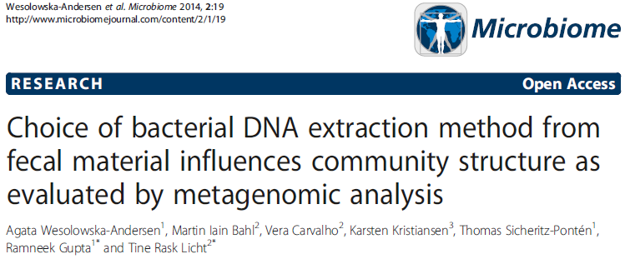
Study-to-study Comparability Was Called Into Question
Conclusions: Whereas it is comforting that the inter-individual variation clearly exceeded the variation resulting from choice of extraction method, our data highlight the challenge of comparing data across studies applying different methodologies.
Data for this analysis was downloaded from MetaPhlan2 website: http://huttenhower.sph.harvard.edu/sites/default/files/gut.HMP+MH.healthy.txt

Slide 3
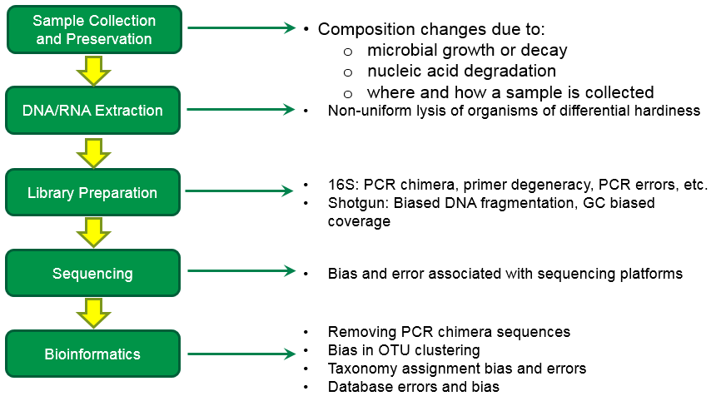
Data Source: Complex Workflow With Multiple Potential Sources of Bias

Slide 4

Bias in Microbiomics Workflows
“bias occurs when systematic error is introduced into sampling or testing by selecting or encouraging one outcome or answer over others.”
https://www.ncbi.nlm.nih.gov/pmc/articles/PMC2917255/

Slide 5
The idea of a known input for benchmarking

Slide 6
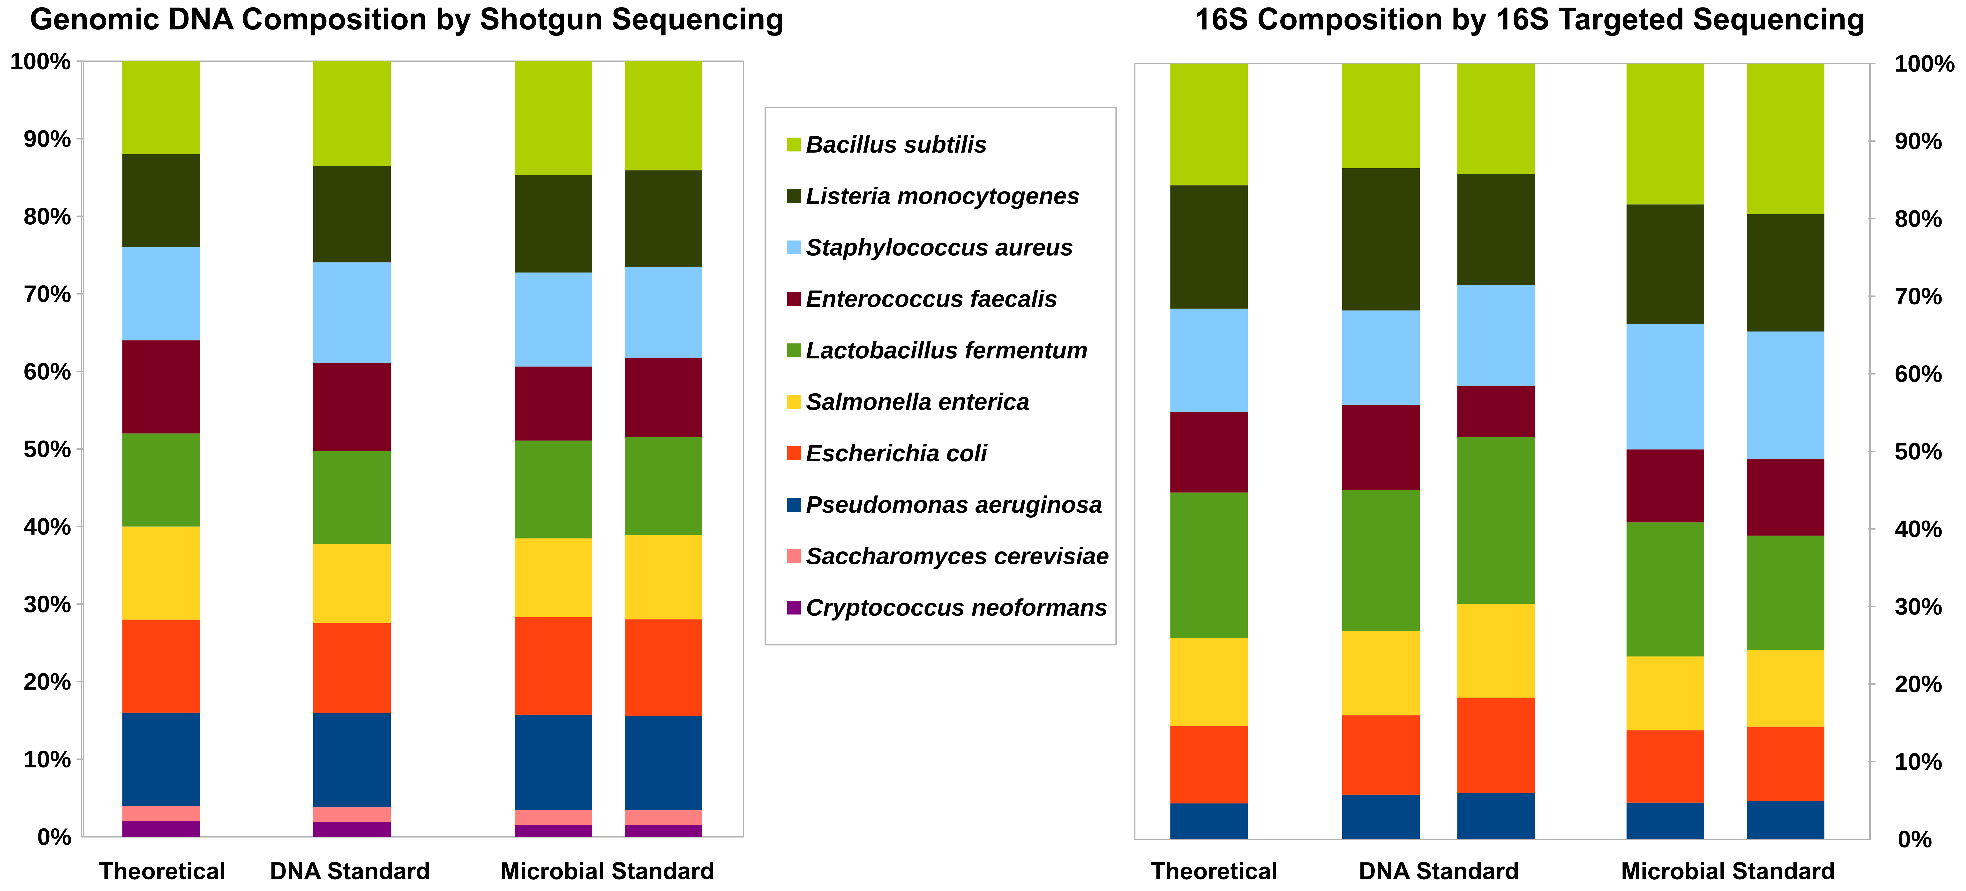
A Standard Ground Truth For Measurement
ZymoBIOMICS Mock Microbial Community
< 15% deviation from defined composition
< 0.01% foreign microbial DNA

Slide 7
A Standard Ground Truth For Measurement
ZymoBIOMICS Mock Microbial Community
Gram Positive
Gram Negative
Fungus (Yeast)

Slide 8
How to measure accuracy relative to a standard?

Slide 9
Measuring Accuracy Relative to a Standard

Slide 10
Measuring Accuracy Relative to a Standard
Listeria
Listeria

Slide 11
Measuring Accuracy Relative to a Standard (adjustment for 15% tolerance)

Slide 12
Measuring Accuracy Relative to a Standard (Transform for Percent Expected)
Percent of Expected

Slide 13
Measuring Accuracy Relative to a Standard (Determine Error Relative to Tolerances)
Percent of Expected

Slide 14
Introducing the measurement integrity quotient (MIQ) score

Slide 15
Measuring Accuracy Relative to a Standard (Determine Error Relative to Tolerances)
MIQ = 93
MIQ = 30
Percent of Expected
MIQ = 100 – RMSE

Slide 16
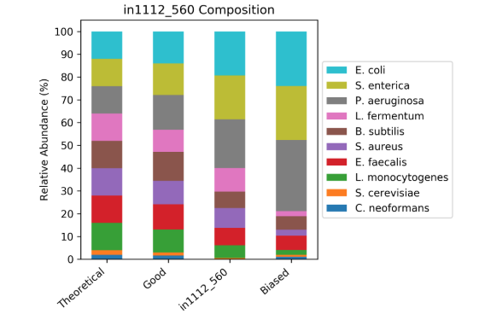
Composition/Taxa Plots Are Insensitive to Inaccuracies

Slide 17
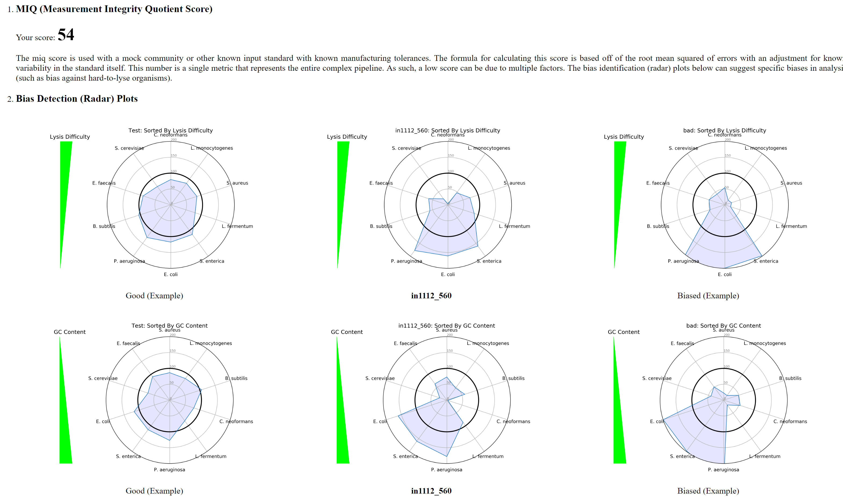
MIQ Score Report (Generated Automatically)
MIQ = 93
Harder to Lyse
Easier to Lyse

Slide 18
MIQ Score Report (Generated Automatically)
MIQ = 54

Slide 19
MIQ Score Report (Generated Automatically)
MIQ = 30

Slide 20

Shotgun MIQ Score is a Complete, Dockerized Pipeline
FASTQ
Pair
SAMTools
Python
BWA
Matplotlib
Report

Slide 21
16S MIQ Score is a Complete, Dockerized Pipeline
FASTQ
Pair
DADA2
Python
FIGARO
Matplotlib
Report

Slide 22
Understanding causes of non-reproducibility and bias

Slide 23
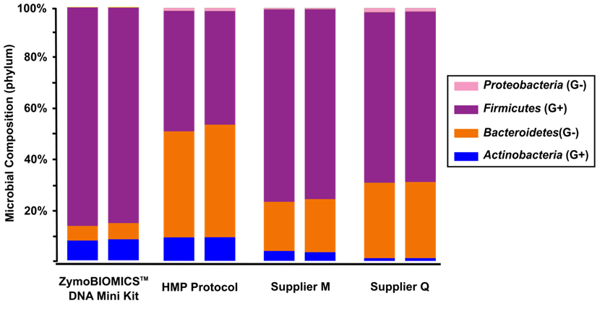
Lack of Reproducibility Between Methods
Supplier Z
Protocol H
Supplier Q1
Supplier Q2

Slide 24
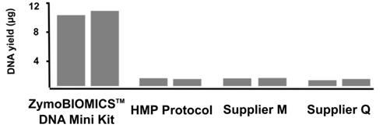
Notable Differences in Total DNA Yield
DNA Yield (μg)
Supplier Z
Protocol H
Supplier Q1
Supplier Q2

Slide 25
Notable Differences in Total DNA Yield
DNA Yield (μg)
Was Something Left Behind?
Supplier Z
Protocol H
Supplier Q1
Supplier Q2

Slide 26
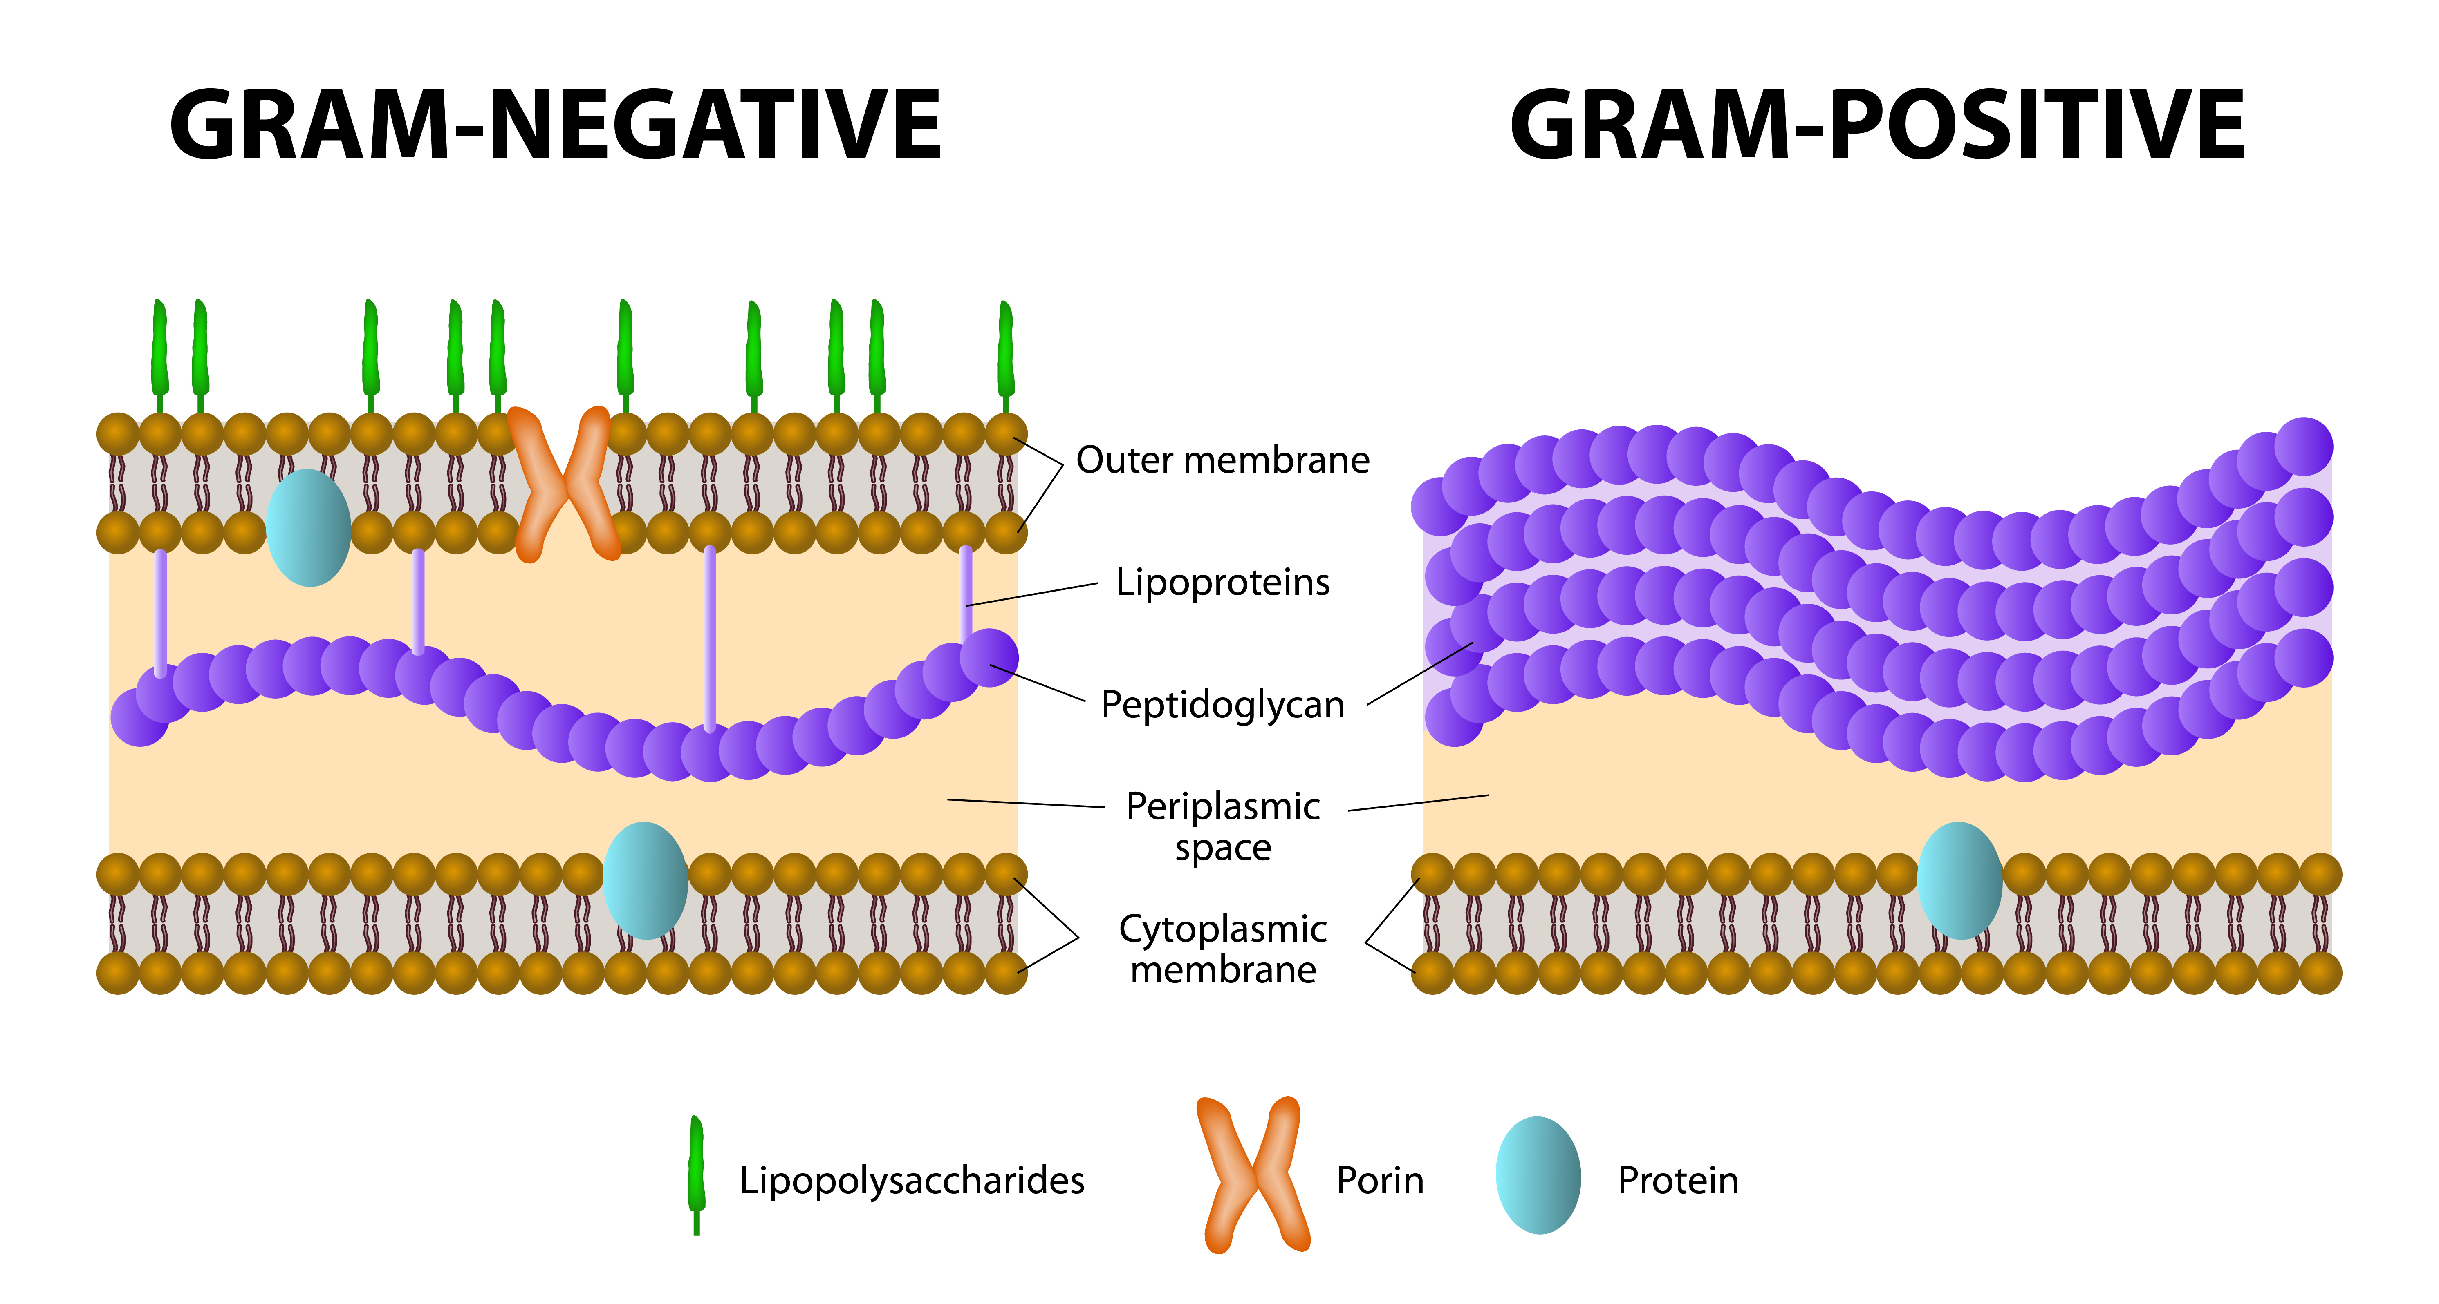
Hypothesis: Physical Differences in Microbes Cause Lysis Bias
Easy to lyse
Difficult to lyse

Slide 27
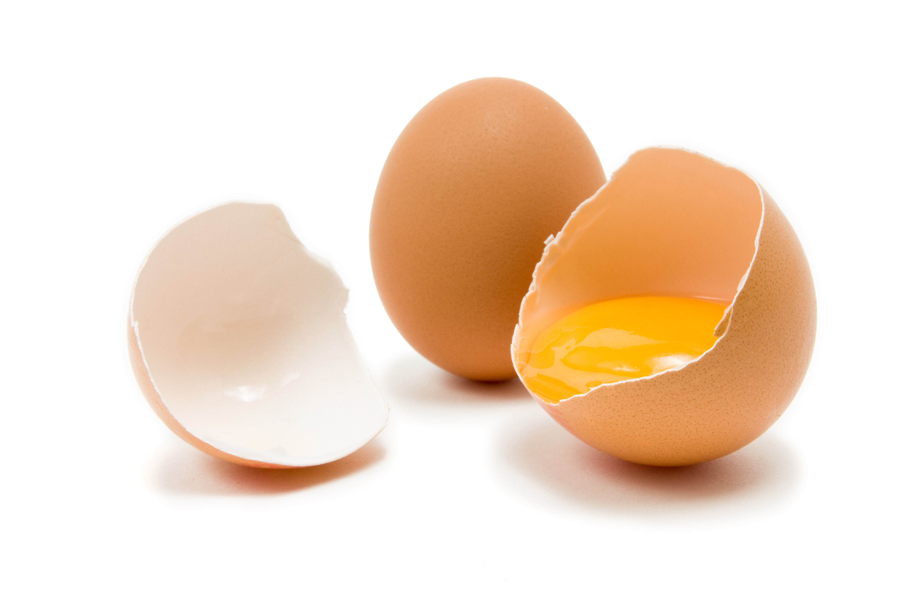
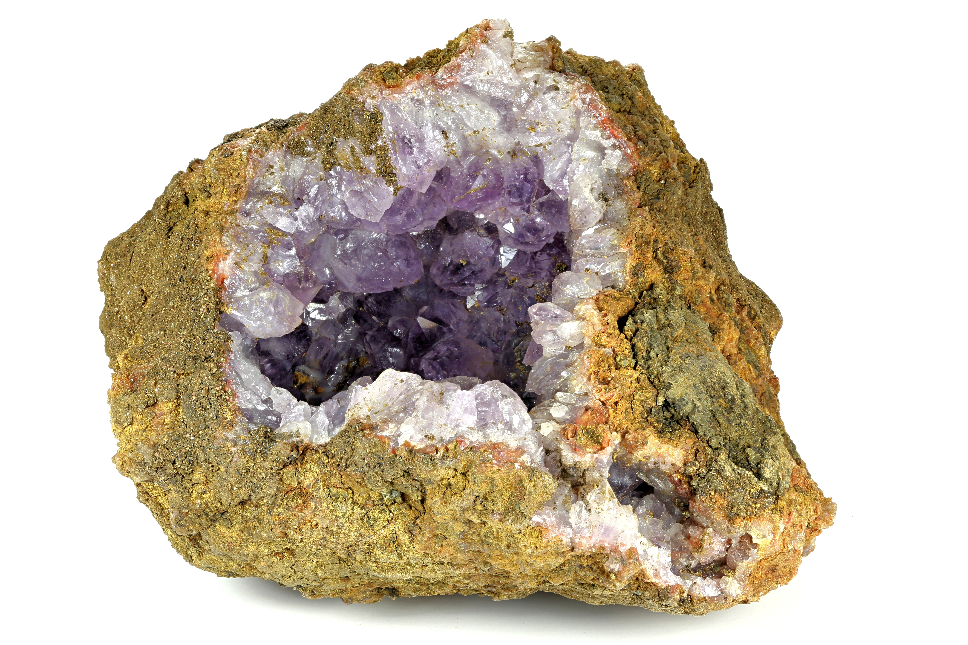
Why Does Extraction Lead to Bias?
Easy to lyse
Difficult to lyse

Slide 28
Chemical/Enzymatic and Mechanical Lysis
Metapolyzyme | — | + | — | + | — | + | — | + | Control
Proteinase K | — | — | + | + | — | — | — | —
Beads | — | — | — | — | After | After | Before | Before

Slide 29
Chemical/Enzymatic and Mechanical Lysis
Bacteria lysing in preservative and a “sham” metapolyzyme treatment
Metapolyzyme | — | + | — | + | — | + | — | + | Control
Proteinase K | — | — | + | + | — | — | — | —
Beads | — | — | — | — | After | After | Before | Before

Slide 30
Chemical/Enzymatic and Mechanical Lysis
Use of Metapolyzyme
Metapolyzyme | — | + | — | + | — | + | — | + | Control
Proteinase K | — | — | + | + | — | — | — | —
Beads | — | — | — | — | After | After | Before | Before

Slide 31
Chemical/Enzymatic and Mechanical Lysis
Adding proteinase K
Metapolyzyme | — | + | — | + | — | + | — | + | Control
Proteinase K | — | — | + | + | — | — | — | —
Beads | — | — | — | — | After | After | Before | Before

Slide 32
Chemical/Enzymatic and Mechanical Lysis
Bead beating after sham/real metapolyzyme treatment
Metapolyzyme | — | + | — | + | — | + | — | + | Control
Proteinase K | — | — | + | + | — | — | — | —
Beads | — | — | — | — | After | After | Before | Before

Slide 33
Chemical/Enzymatic and Mechanical Lysis
Bead beating before sham/real metapolyzyme treatment
Metapolyzyme | — | + | — | + | — | + | — | + | Control
Proteinase K | — | — | + | + | — | — | — | —
Beads | — | — | — | — | After | After | Before | Before

Slide 34
Chemical/Thermal Lysis
Heat (95°C) | — | — | — | — | — | 1 min | 10 min | 1 min | 10 min | Control
Heat (55°C) | — | — | — | + | + | — | — | 20 min | 20 min
Proteinase K | — | + | — | — | + | — | — | + | +
Vortex Genie | — | — | 20 min | — | — | — | — | — | —

Slide 35
Bead Size Has a Strong Effect With an Optimal Range

Slide 36
Mixed Beads From Both Ends of the Optimal Range Are Better Than Individual Sizes
0.1mm + 0.5mm

Slide 37
What effect do bead beaters have?

Slide 38
A Standard Ground Truth For Measurement
ZymoBIOMICS Mock Microbial Community
Gram Positive (Hard)
Gram Negative (Easy)
Fungus (Hard)

Slide 39
MPBio FastPrep 24

Slide 40
MPBio FastPrep 24
Target Zone

Slide 41
MPBio FastPrep 24

Slide 42
MP Bio Fastprep 24

Slide 43
Vortex Genie + Adapter

Slide 44
Vortex Genie + Adapter

Slide 45
How Does This Affect My Results? F/B ratio at least is changed
Bacterial MIQ Score calculated using ZymoBIOMICS mock community standard
Firmicutes/Bacteroidetes ratio calculated on a repeated stool sample with identical processing, other than bead matrix
Each point represents the mean of at least three replicates using a different bead matrix, with other processing steps identical
Pearson Correlation = 0.835, p = 3.7×10^{–11}

Slide 46
Sample collection and preservation

Slide 47
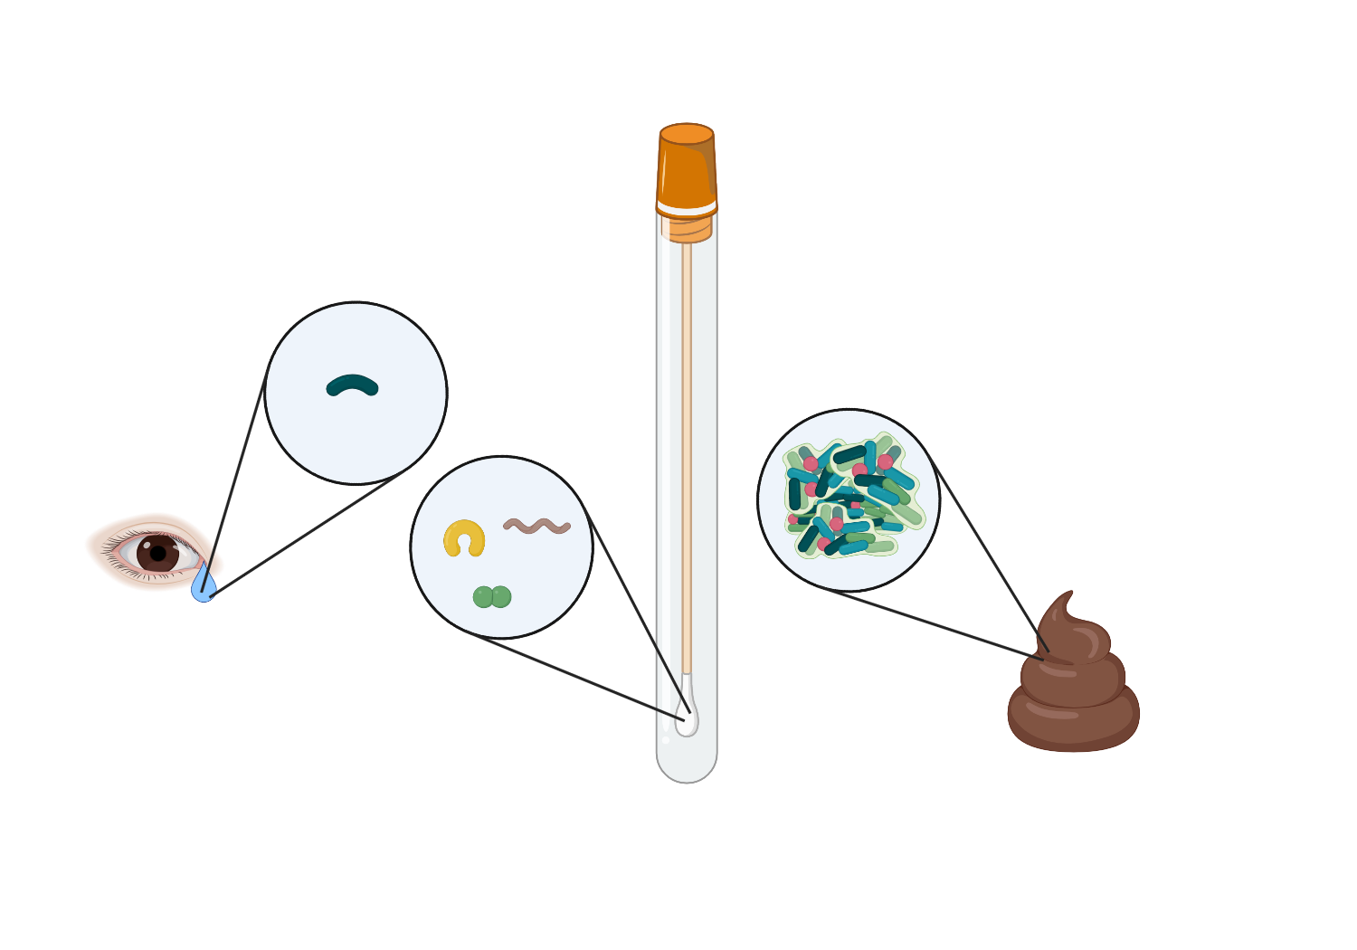
Bioburden: AKA the Kit-ome

Slide 48
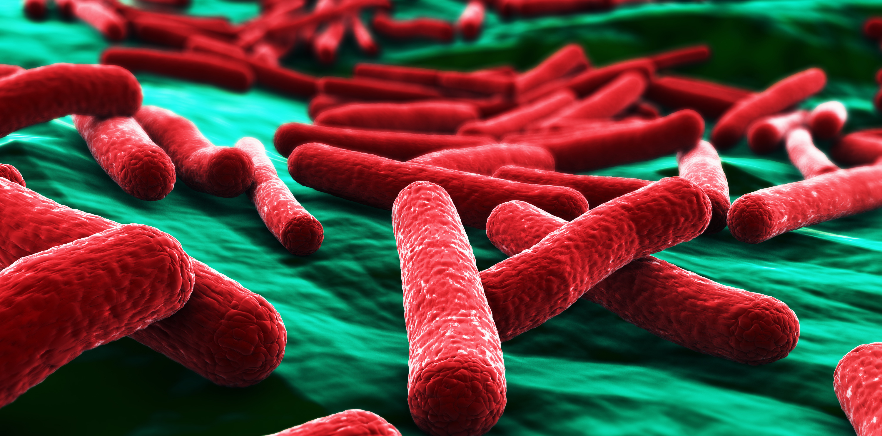
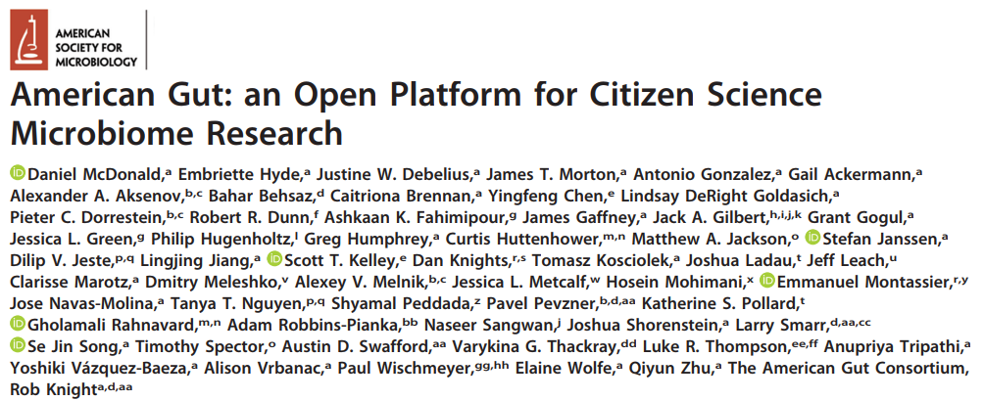
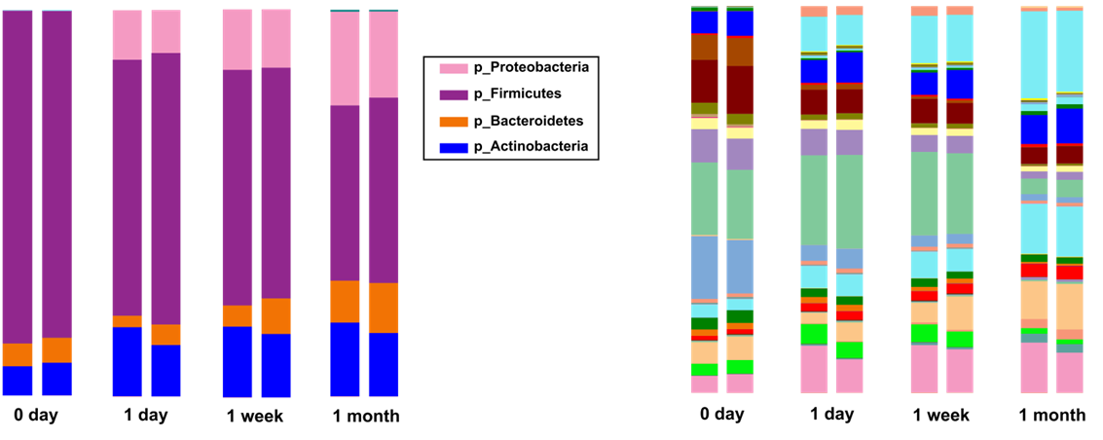
A Microbiome Is a Living Sample, Responsive to Environmental Conditions
May/June 2018 Vol 3 (3) e00031-18
Stool Samples at Room Temperature
Notes:
Bacterial Growth/Decay and Nucleic Acid Degradation Compromise Microbiome Measurements
Stool samples stored at ambient temperature over 1 month
Major publications facing the challenge of sample collection
Bias from Sample Collection Required “Editing” the Data to Try and remove Bacterial Blooms
Bias from Sample Collection Required “Editing” the Data to Try and remove Bacterial Blooms

Slide 49
A Microbiome Is a Living Sample, Responsive to Environmental Conditions
“Removal of bacterial blooms. […] Escherichia coli and a few other taxa grow in transit, so based on data from controlled-storage studies as previously described (15), we removed sub-operational taxonomic units (sOTUs) (16 ) (median of 7.9% of sequences removed per sample) shown to bloom.”
May/June 2018 Vol 3 (3) e00031-18
Stool Samples at Room Temperature
Notes:
Bacterial Growth/Decay and Nucleic Acid Degradation Compromise Microbiome Measurements
Stool samples stored at ambient temperature over 1 month
Major publications facing the challenge of sample collection
Bias from Sample Collection Required “Editing” the Data to Try and remove Bacterial Blooms
Bias from Sample Collection Required “Editing” the Data to Try and remove Bacterial Blooms

Slide 50
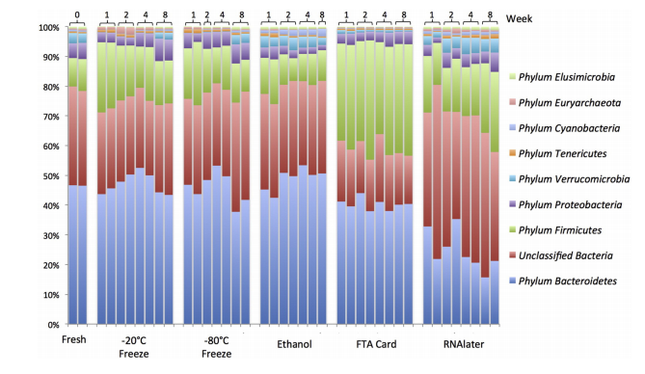
Use of RNA Preservative Causes a Loss of Bacteroidetes
Modified from Hale, V. L., Tan, C. L., Knight, R., & Amato, K. R. Journal of Microbiological Methods, 113, 16-26.

Slide 51

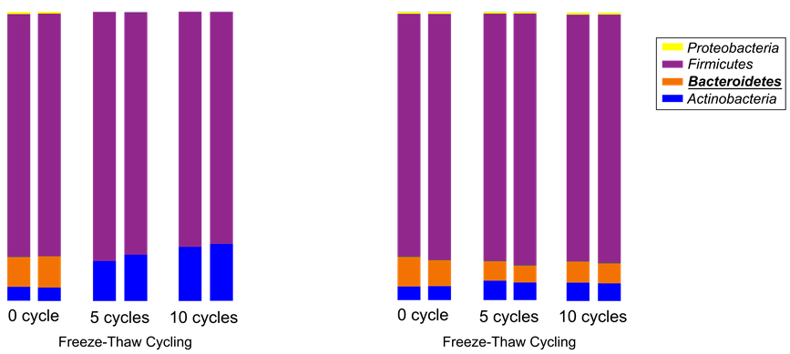
Freeze/Thaw Causes a Loss of Bacteroidetes
Stool WITHOUT Preservative
Number of Freeze Thaw Cycles

Slide 52
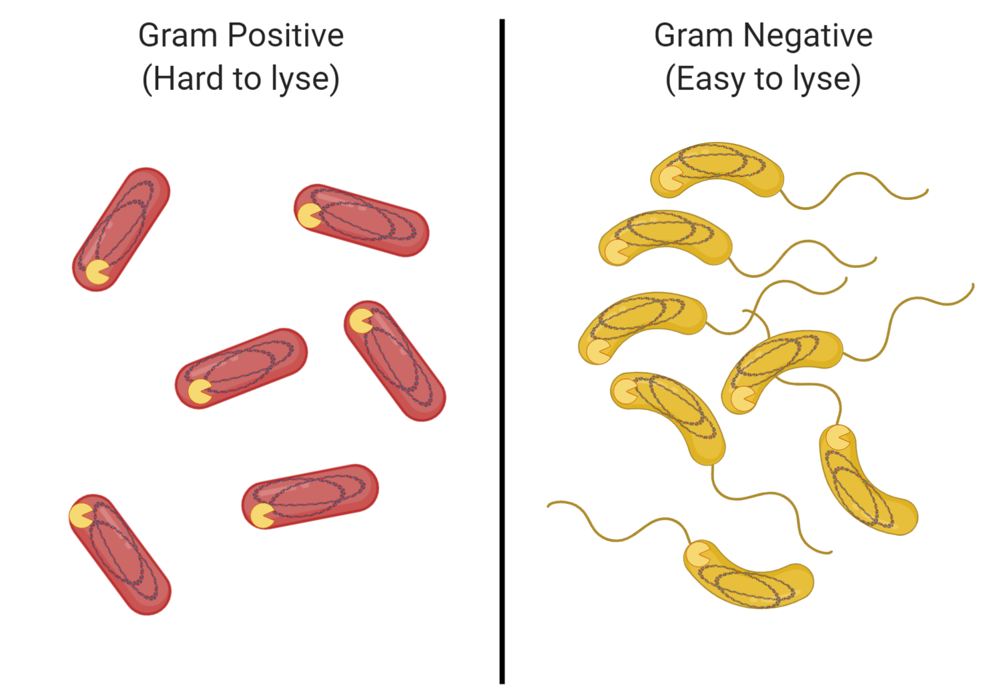
A Tale of Two Microbes

Slide 53
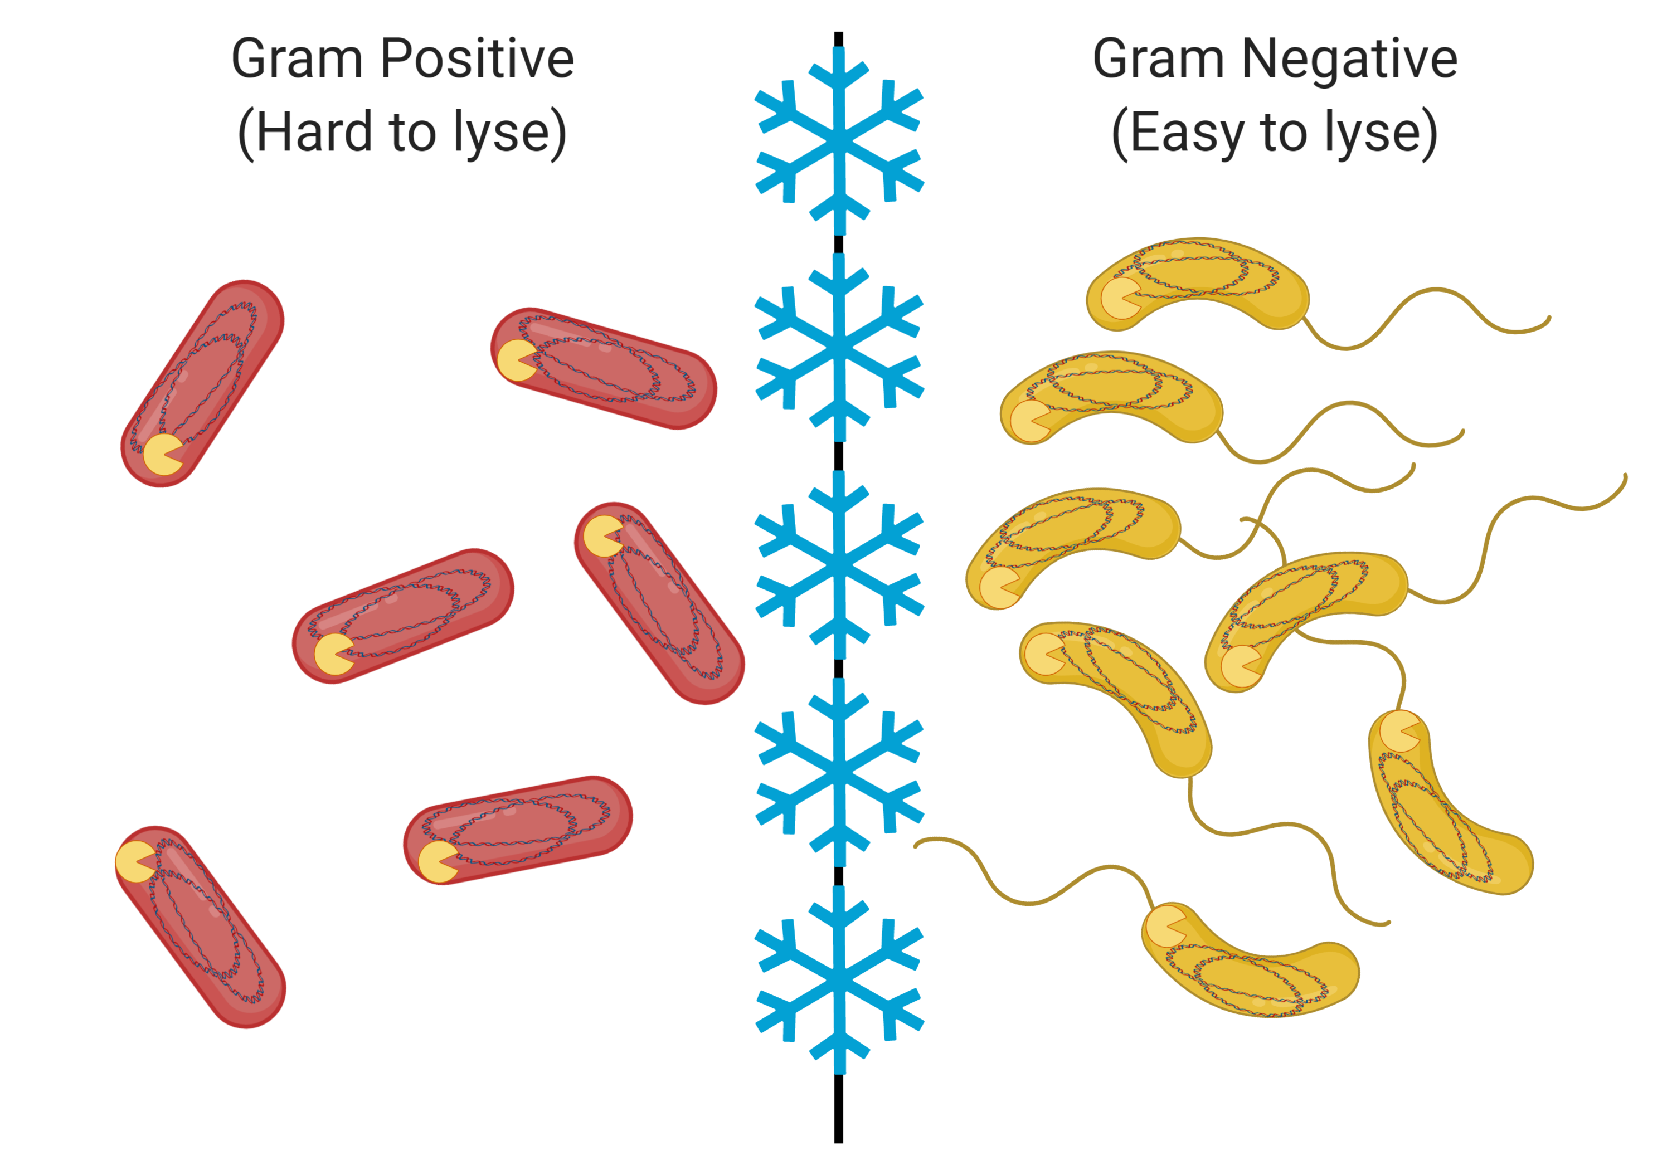
Use of Freezing as a Preservative

Slide 54
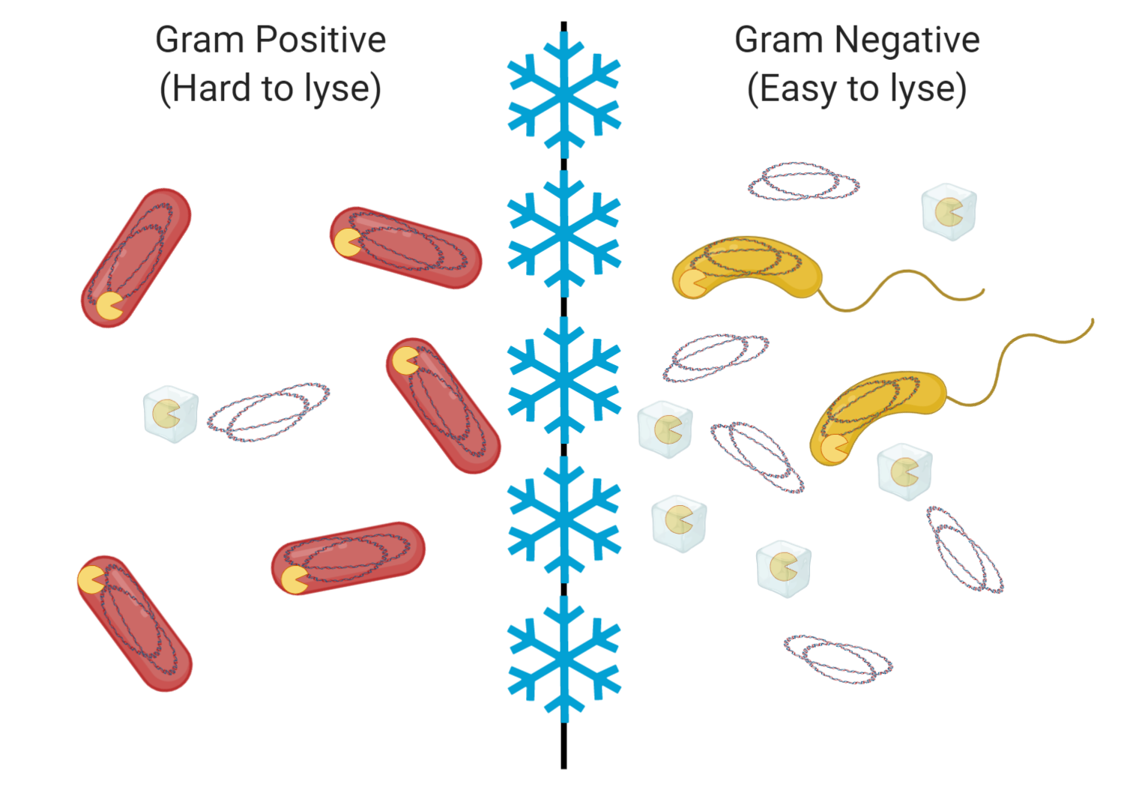
Freezing Lyses More Fragile Bacteria at a Higher Rate

Slide 55
But Freezing Also Inhibits Degradative Enzymes

Slide 56
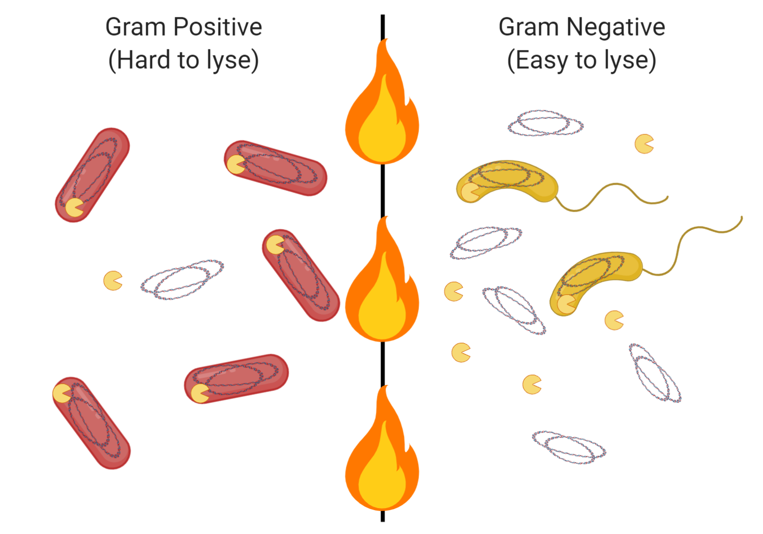
Thawing Restores Activity to Enzymes

Slide 57
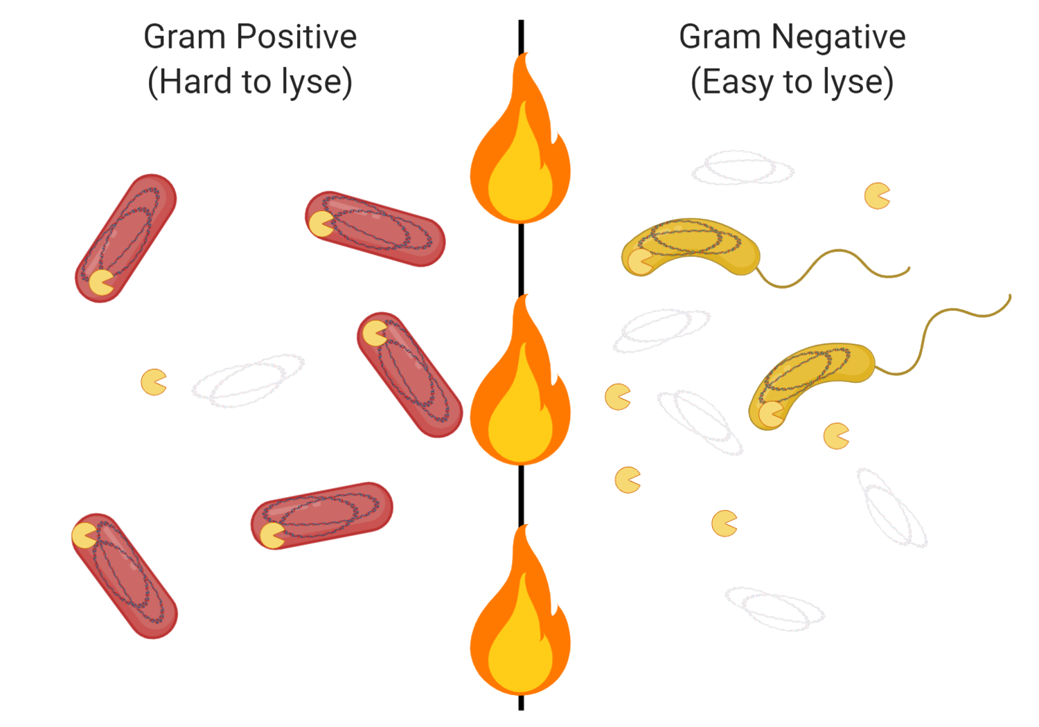
Active Enzymes Degrade Unprotected DNA

Slide 58
Will rapid denaturing/inhibition of nucleases help?

Slide 59
Be Ready For Degradative Enzymes with Inhibitor

Slide 60
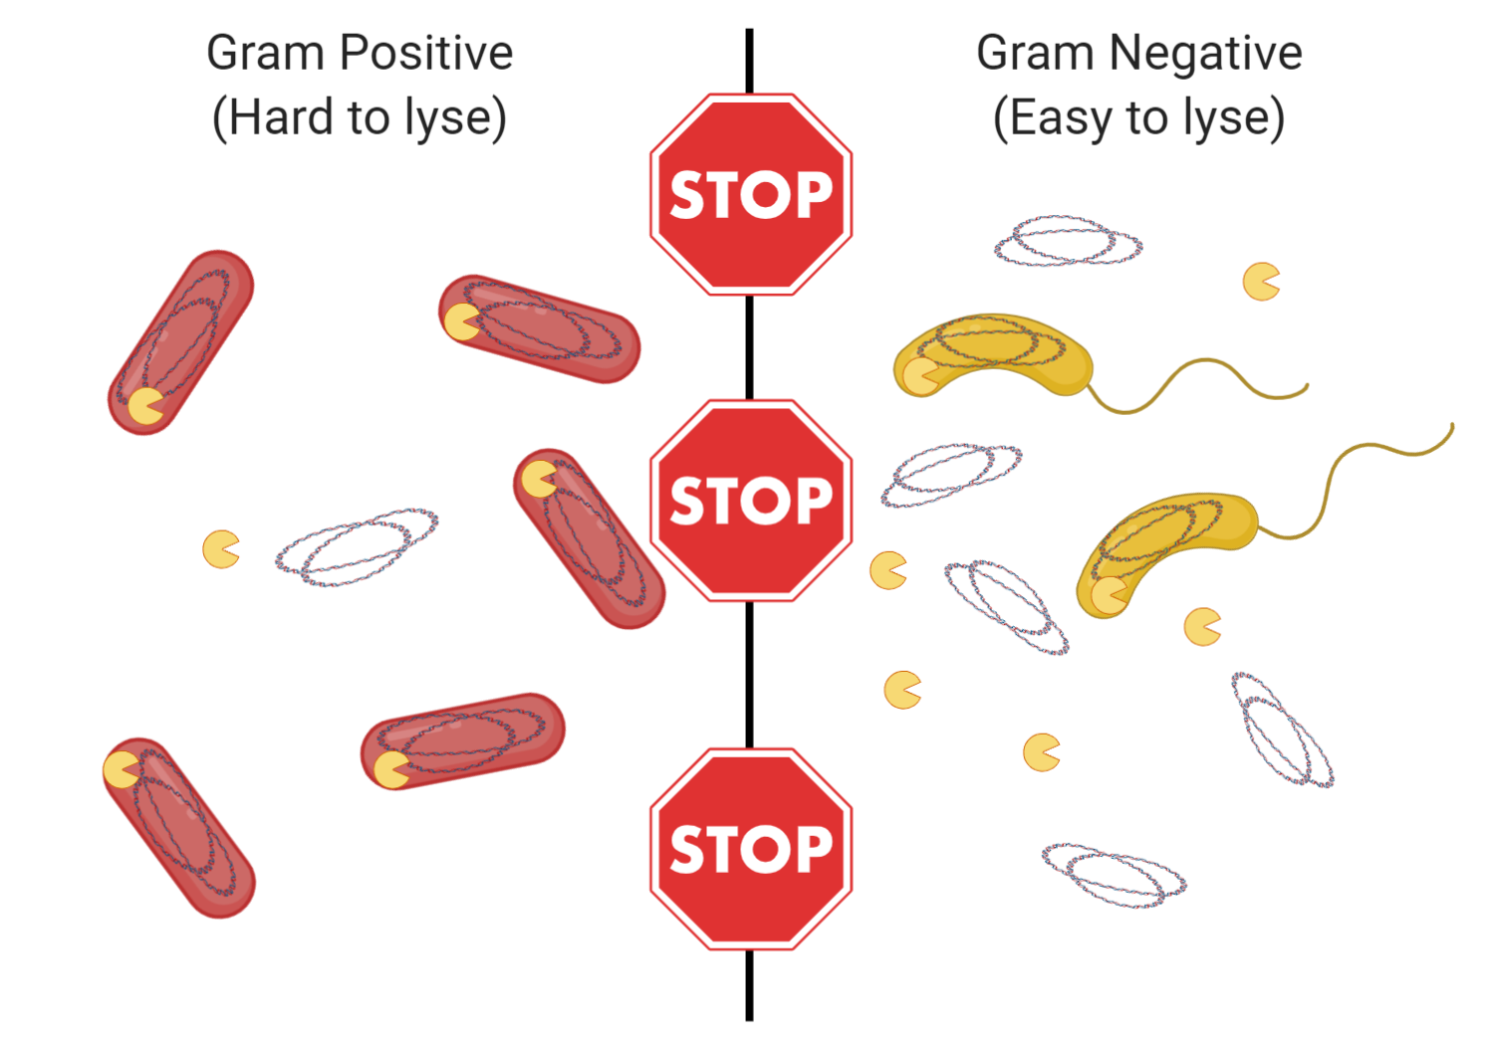
Enzymes Thaw in the Presence of Inhibitor…

Slide 61
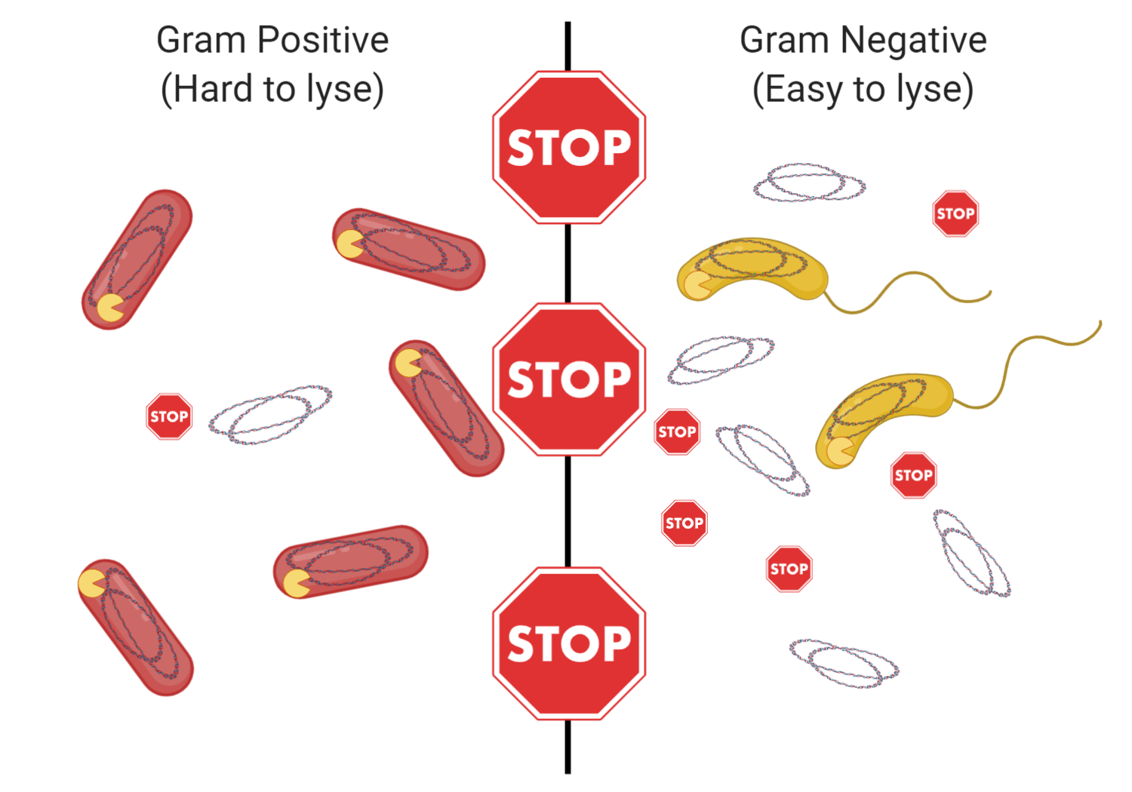
…and Are Stopped Before Significant Degradation

Slide 62
Are all inhibitors suitable for this?

Slide 63
Use of RNA Preservative Causes a Loss of Bacteroidetes
Modified from Hale, V. L., Tan, C. L., Knight, R., & Amato, K. R. Journal of Microbiological Methods, 113, 16-26.

Slide 64
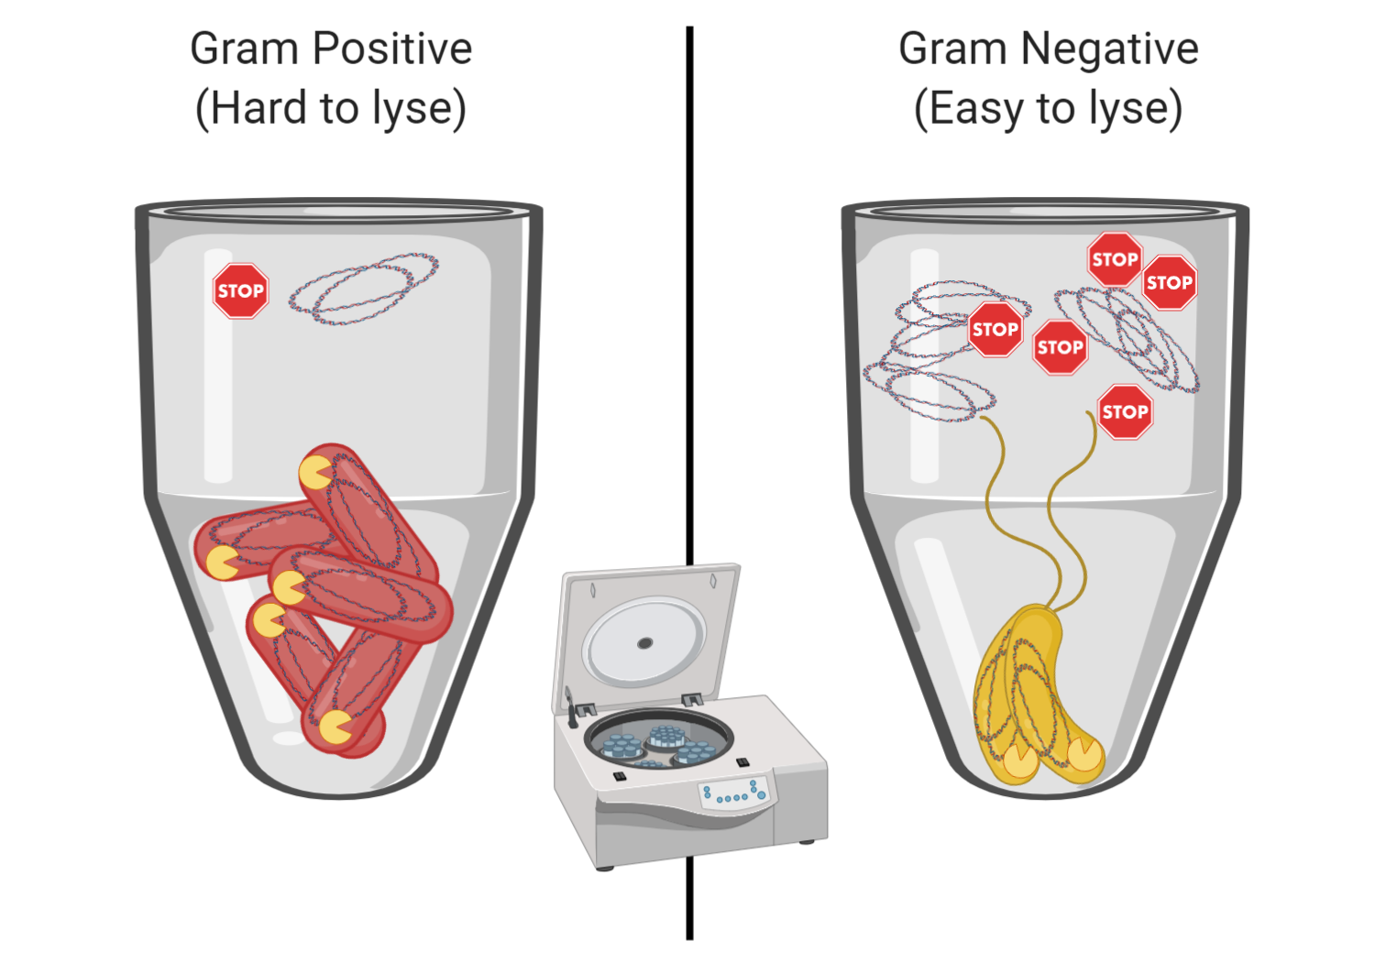
If the Inhibitor Cannot Go Through Purification, DNA From Lysed Cells Is Lost

Slide 65
If the Inhibitor Cannot Go Through Purification, DNA From Lysed Cells Is Lost
“What about adding the sample directly to inhibitor?”
Inhibitors themselves tend to be denaturing and cause cell lysis, creating the same situation as freezing and generally targeting the same (more fragile) microbes.

Slide 66
On microbial sequence databases

Slide 67
A Very Brief History of Microbiology
And how microbiology was funded throughout it
Because labs run on ideas and money.
van Leeuwenhoek invents better microscope optics, discovers “animalcules” in water drops and everywhere else he looks
Some interest, but mostly a curiosity
Pasteur discovers that microbes carry out commercially important fermentation.
Also that they carry out commercially important food spoilage
And (along with Koch) that microbes and not bad air (miasmas), evil spirits, or vengeful deities cause illness
Biochemists and molecular biologists in the later half of the 20th Century want to understand the mechanics of life
E. coli provide an excellent model, basic mechanics of life are characterized in E. coli strains
E. coli becomes the workhorse of biology

Slide 68
A Very Brief History of Microbiology
And how microbiology was funded throughout it
Because labs run on ideas and money.
van Leeuwenhoek invents better microscope optics, discovers “animalcules” in water drops and everywhere else he looks
Some interest, but mostly a curiosity
Microbial ecology is born, interest is limited

Slide 69
A Very Brief History of Microbiology
And how microbiology was funded throughout it
Because labs run on ideas and money.
Pasteur discovers that microbes carry out commercially important fermentation.
Also that they carry out commercially important food spoilage
And (along with Koch) that microbes and not bad air (miasmas), evil spirits, or vengeful deities cause illness
Microbiology suddenly becomes of general interest due to health implications
Microbiology suddenly becomes of great financial interest due to market for fermented products (wine, beer, etc.) or prevention of spoilage

Slide 70
A Very Brief History of Microbiology
And how microbiology was funded throughout it
Because labs run on ideas and money.
Biochemists and molecular biologists in the later half of the 20th Century want to understand the mechanics of life
E. coli provide an excellent model, basic mechanics of life are characterized in E. coli strains
E. coli becomes the workhorse of biology
Lots of E. coli strains already thoroughly characterized and in the lab, waiting to be sequenced
Understanding the mechanics of life is a key to medical innovations that can make a lot of money

Slide 71
Consequences of This History
Why our databases are good for some and terrible for others
You get what you (and others) pay for
If E. coli are found, most databases will have several strains to compare to
If you find a pathogen (or something close to one), it will be well-represented in the database, with at least one, and probably a few strains to compare to.
If you are sequencing microbes that are on or in humans or other well-studied animals, your microbes will probably be represented in the database
If you are studying food, or find microbes similar to those that can carry out commercially important food spoilage or fermentation, they will probably be well-represented.
If you are studying environmental microbiology, especially of more remote or obscure environments, the databases may confound you more than help.

Slide 72
Databases Are Imperfect
Researchers are encouraged to submit new sequences
The are less-strongly encouraged to have rigorous quality control
Sequences can be found in databases that are clearly chimera in origin
Someone did poor chimera removal
Sequences can be found listed under one species that clearly cluster much more closely with a different family, sometimes even a different phylum
Someone made an error when cataloging or recording the name or assigning taxonomy
Sequences can be found that are identical between poorly-related species
Same as above
Database updates often contain significant amounts of both material removal and material addition.
DON’T CONTRIBUTE TO GARBAGE IN THE DATABASES!

Slide 73
Diversity metrics

Slide 74
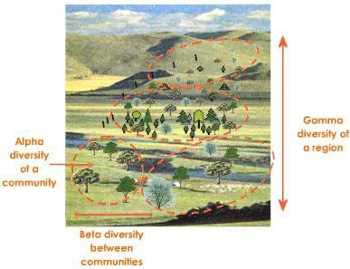
Diversity Types
Alpha Diversity
How many different species are in my sample and how evenly are they distributed?
A monoculture has no alpha diversity. A sample with multiple species where only one is very predominant will also be very low.
Intrinsic property of the sample itself, no “better” or “worse” result, just more or less accurate.
High or low is not inherently better or worse, all depends on context.

Slide 75
Diversity Types
Beta Diversity
How similar/different are two samples?
The gut and oral microbiomes tend to have high alpha diversity, but may have low beta diversity between between similar individuals.
Beta diversity between an individual with IBD and a healthy gut will be extremely high.

Slide 76
Diversity Types
Gamma Diversity
How diverse is this multi-site ecosystem?
Rarely used in metagenomics

Slide 77
Thank You!

